Slide 1
Moment of Inertia
Shao-Hsuan Wang
Institute of Statistical Science, Academia Sinica

Slide 2
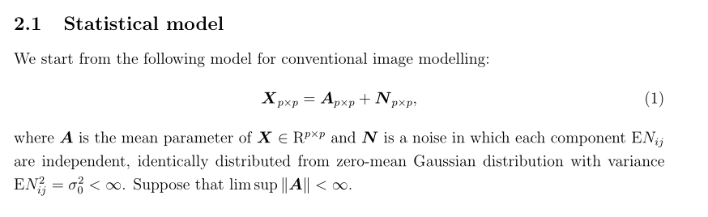
Statistical Model

Slide 3
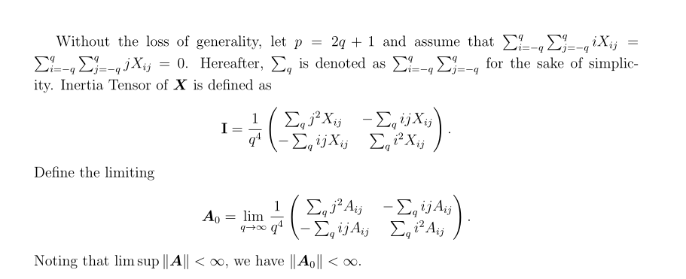



Image

Slide 4
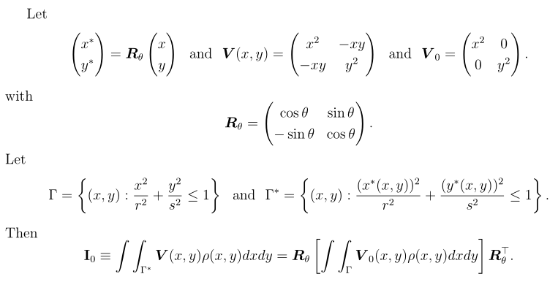
Moment of Inertia

Slide 5
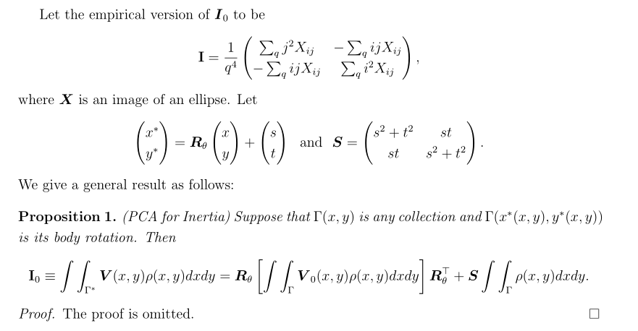

Slide 6
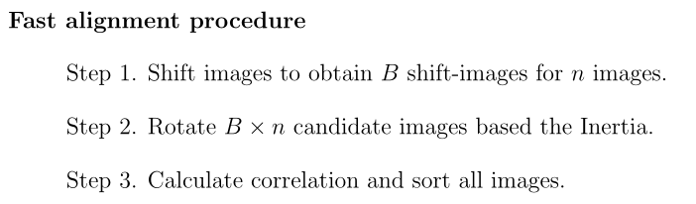
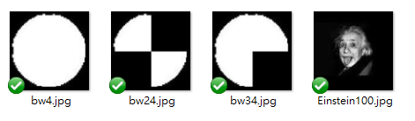
Ref

Slide 7
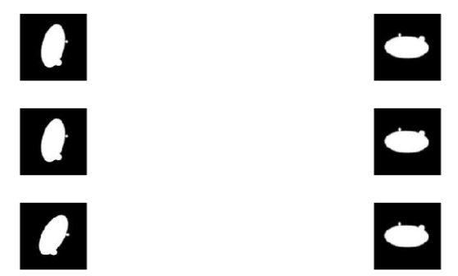
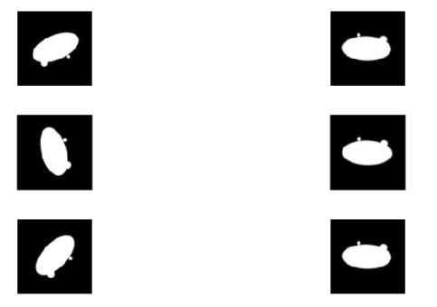
Before
After
Before
After

Slide 8
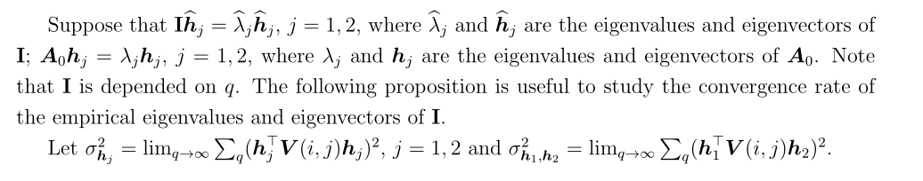
Statistical Properties

Slide 9
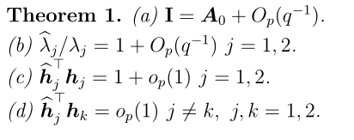
Consistency

Slide 10
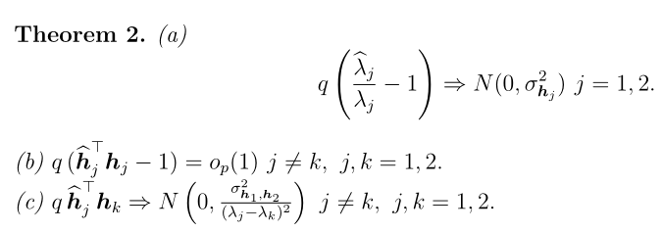
Asymptotic Normality

Slide 11
Working on …
FI2D V.S. FRM2D
Confidence range for the empirical angles
The relation between SNR and the Interia

